Slide 1

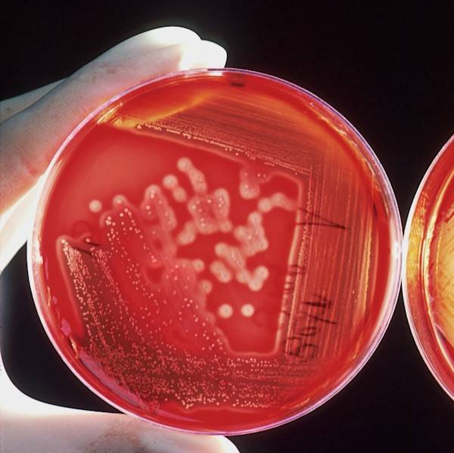
Introduction to infections
Good day. Today I would like to present a topic called “Infections in Medicine: Types, Characteristics, and Clinical Importance. ”
An infection is a pathological process that occurs when pathogenic microorganisms invade the human body, multiply, and cause disease.

Slide 2

Mechanisms of infection
These microorganisms can damage tissues and lead to different clinical symptoms. Infectious diseases are one of the major causes of morbidity and mortality worldwide and remain a significant challenge for modern medicine. Early detection and appropriate treatment are crucial for reducing the impact of infectious diseases on public health.
Research into new vaccines and antibiotics continues to be a priority to combat these threats effectively.

Slide 3
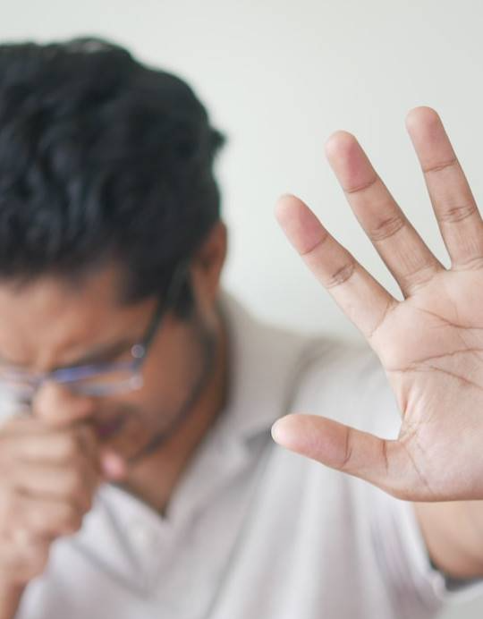
Main types of infectious agents
There are five main types of infectious agents that cause diseases in humans: bacteria, viruses, fungi, parasites, and prions.
Each type of infectious agent has unique characteristics and mechanisms of action, which determine the methods of diagnosis and treatment. Some infectious diseases can be prevented through vaccination and good hygiene practices.

Slide 4
Bacterial infection
Bacteria are prokaryotic microorganisms that are capable of independent reproduction. Many pathogenic bacteria produce toxins that can cause serious harm to the body. Some bacterial infections can be treated with antibiotics, but the emergence of antibiotic-resistant strains poses a significant threat to public health.
Understanding the mechanisms of bacterial infection is crucial for developing effective prevention and treatment strategies.

Slide 5
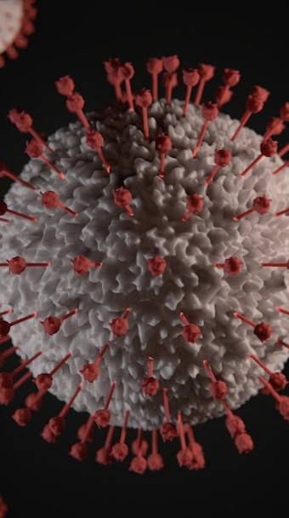
Characteristics of bacteria
Bacteria are prokaryotic microorganisms that are capable of independent reproduction.
Many pathogenic bacteria produce toxins that can cause serious harm to the body. Bacterial infections can lead to a variety of diseases, from mild to life-threatening. Rapid detection and treatment of bacterial infections are crucial for preventing the development of serious complications.

Slide 6

Thanks for watching!

